Slide 1

ENCRYPTO AND DECRYPTO METHOD
By
Saranya .T
16UG08047

Slide 2

Index
Abstract
Introduction
Objective
Technology used
Advantage and disadvantage
Results
Conclusion
References

Slide 3
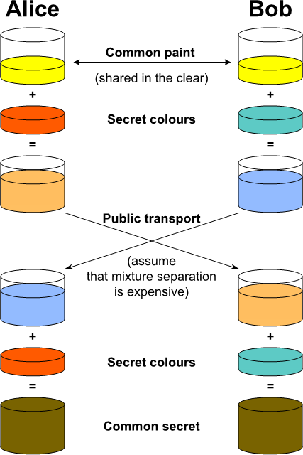
INTRODUCTION

Slide 4
PROPOSED SOLUTION
Step 01 - Create a Class Library
Step 02 - Add fields
Step 03 - Add a constructor
Step 04 - Expose Public Key and IV
Step 05 - Create an Encrypt method
Step 06 - Create a Decrypt method
Step 07 - Dispose unmanaged resources
Step 08 - Create a test class

Slide 5
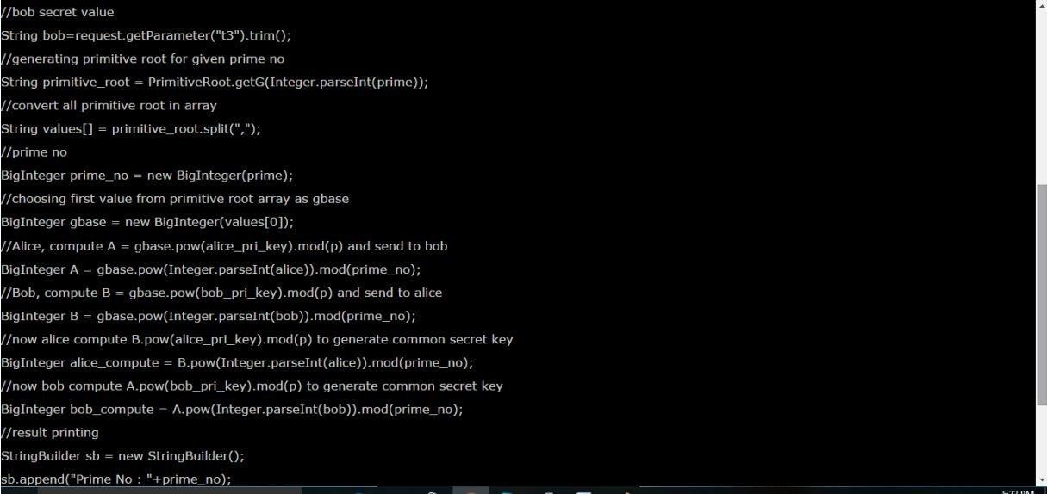
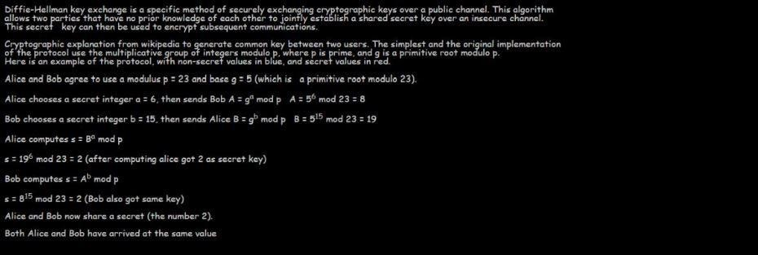
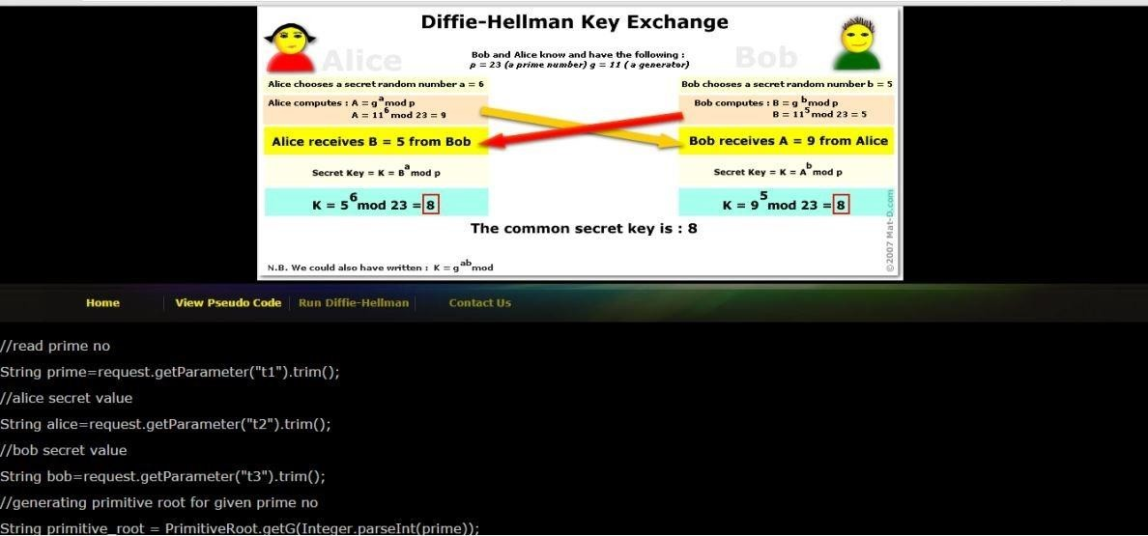
TESTING

Slide 6
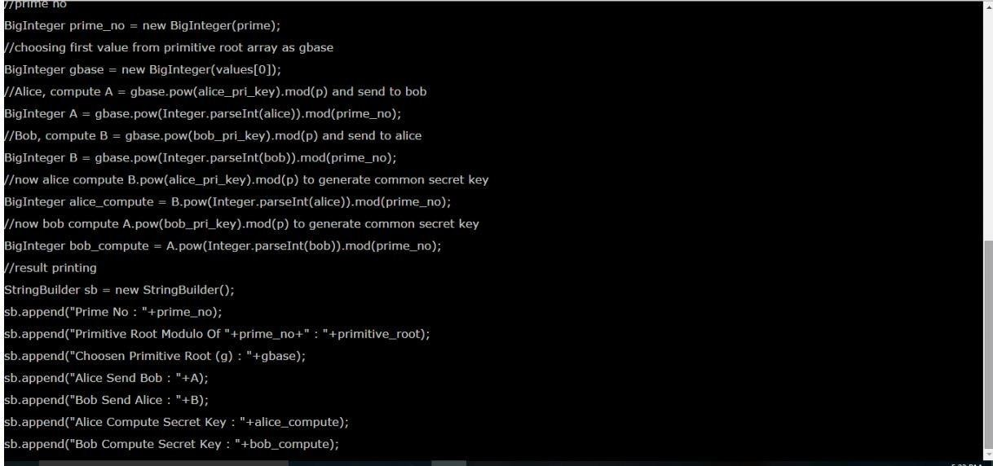
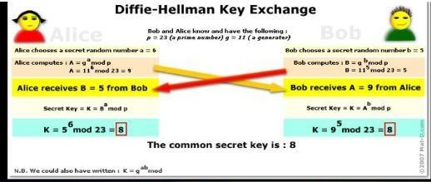
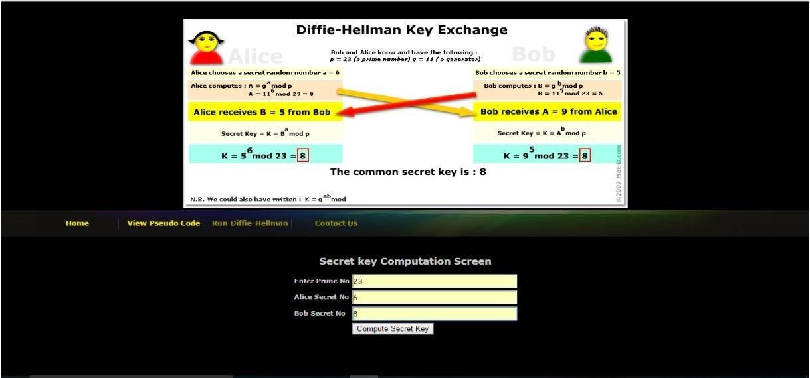
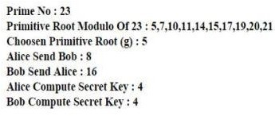

Slide 7
Objective
We create a cryptographic class which has two methods - encrypt and decrypt.
These two methods will allow us to exchange public key with the other party and decrypt the secret messages with private key.
The secret message will be encrypted using standard AES encryption

Slide 8
TECNOLOGY USED
By Diffie Hellman Method.
Visual studio
.NET Code

Slide 9
ADVANTAGES AND DISADVANTAGES
There are always two sides to a coin.
Educating an individual with the ins and outs of hacking with the objective to not maliciously use skill.
It can always turn out helpful but it also poses potential danger and threat of teaching the same skills to enable a hacker to hack with the wrong intent.
System technology keeps developing and changing over time proceeding to a more elevated level.
Operating frameworks need to keep up with the changes in the systems and adapt accordingly.
Hacking needs to be approached and taught with keeping an ethical principle in mind.
Those who want to educate themselves can do so through other means of learning which can exist without strict guidelines which do not necessarily classify as moral or immoral.

Slide 10
RESULT
Diffie-Hellman in light of the fact that it can give much more prominent security at a littler key size.
ECC takes less computational time and can be utilized to secure data on smaller machines, including mobile phones, smart cards and wireless devices.
That is one reason the National Security Agency needs to move to elliptic-bend cryptography (ECC) for cyber security.
The cryptographic security standards utilized as a part of public-key infrastructures, RSA and Diffie-Hellman

Slide 11


Slide 12


REFERENCES
Cryptography Network Security, and Cyber Laws by Bernard L. Menezes And Ravinder Kumar
Hellman M. (2002, May). An Overview of Public Key Cryptology.
ee.stanford.edu/~hellman/publications/31.pdf
Eun-Jun Yoon and Kee-Young Yoo, “An Efficient Diffie- HellmanMAC Key Exchange Scheme”, 2009
Fourth International Conference on innovative Computing, Information and Control.

Slide 13
ANY QUESTIONS ????

